Slide 1
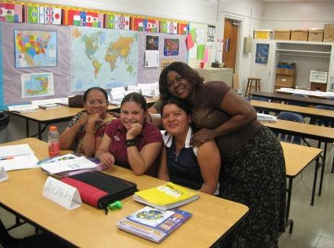


December 11, 2012
Lori Cabrera
Teaching Health to
Low Literacy Adult ESOL students

Slide 2
1. Introductions
2. The Good, the Bad, and the UGLY
(Teaching health to low-literacy students)
3. Differences in how Literate
and Non-Literate students learn
4. The UGLY gets a Makeover:
Modifications and Best Practices
Choosing the right text for your level
5. Top 10 Best Activities for
Low-Literacy ESOL Students

Slide 3



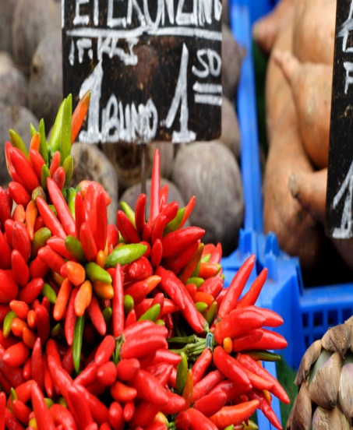
Extreme
Motivation
Rich Life
Experience
Family
Support
System/
Slower Pace
Healthier
Cooking
The Good

Slide 4


Poor
Study
Skills
Lack of
Organization
Low
Confidence
The Bad

Slide 5
…and the UGLY
Five big problems and how to address them
Lack of comfort/experience in an
educational setting
Classroom is scary and foreign
Must build confidence from day one
Need help following along & organizing
Don’t understand grades

Slide 6
2. Physical Barriers
Age
Stiff vocal apparatus
Energy level
Vision problems

Slide 7
Slower in Processing and Producing
Language
Need patience, empathy, & encouragement
Increased wait time
Page numbers in large print on board
Give directions in native language if possible

Slide 8
4. Problems Understanding Graphics
Difficulty interpreting 2-D drawings
Trouble reading maps, charts, or graphs
Problems with standardized tests

Slide 9
5. Different Cultural Views
Differing world view
Different values (individual vs. group orientation)
Fatalism; extreme present-orientation
Health beliefs not based on facts (some examples)

Slide 10
Differences/Similarities between literate and non-literate learners
Your
Non-literate
students
You
Literate Learners | Non-Literate Learners
Learn from print | Learn by doing and watching
Tend to be visually oriented | Tend to be aurally oriented
Make lists to remember | Repeat to remember
Spend years learning to read | Have limited time for learning to read
Know they can learn | Lack confidence in their learning ability
Learn best when content is relevant to their lives | Learn best when content is relevant to their lives
Can distinguish between important and less important points | May accept all content as being of equal value
from “What Non-Readers or Beginning Readers Need to Know, “
The Spring Institute for Intercultural Learning, 1999

Slide 11
The Makeover:
Modifications
Visuals- Visuals are probably the most important thing to increase comprehension (the more real-life, the better)
Mixed-Level Grouping- Pair him/her with higher level student; use native language assistance to help explain difficult concepts. All students should use the same materials but are expected to do different tasks.
Oral before written- When students build oral skills in their new language first, it is much easier for them to learn to read in the new language.
More time- Move slowly & don’t present too much new material at once. Limit the number of chapters covered. Give them time before expecting them to respond. (WAIT TIME up to 15-20 seconds!)

Slide 12
(continued)
Build phonics skills- Decoding skills are essential- start with the sounds that are the same in their native language.
Build vocabulary- Teach them to create their own bilingual dictionary, adding new key vocabulary as it is introduced. Give them a word list of the 100 most commonly used words in English.
Highlight- Have them underline or highlight key words so they can pick out what is important from what is not.
Write simpler materials summarizing readings –Use Comic Sans font, graphics, & visuals. Avoid passive voice, idioms, & higher-level vocab.
White space is your friend- Use cut-out (example on next slide) to cover up the rest of the page as students are reading. Too many words on the page are intimidating for them. Slide it down as they go.

Slide 13
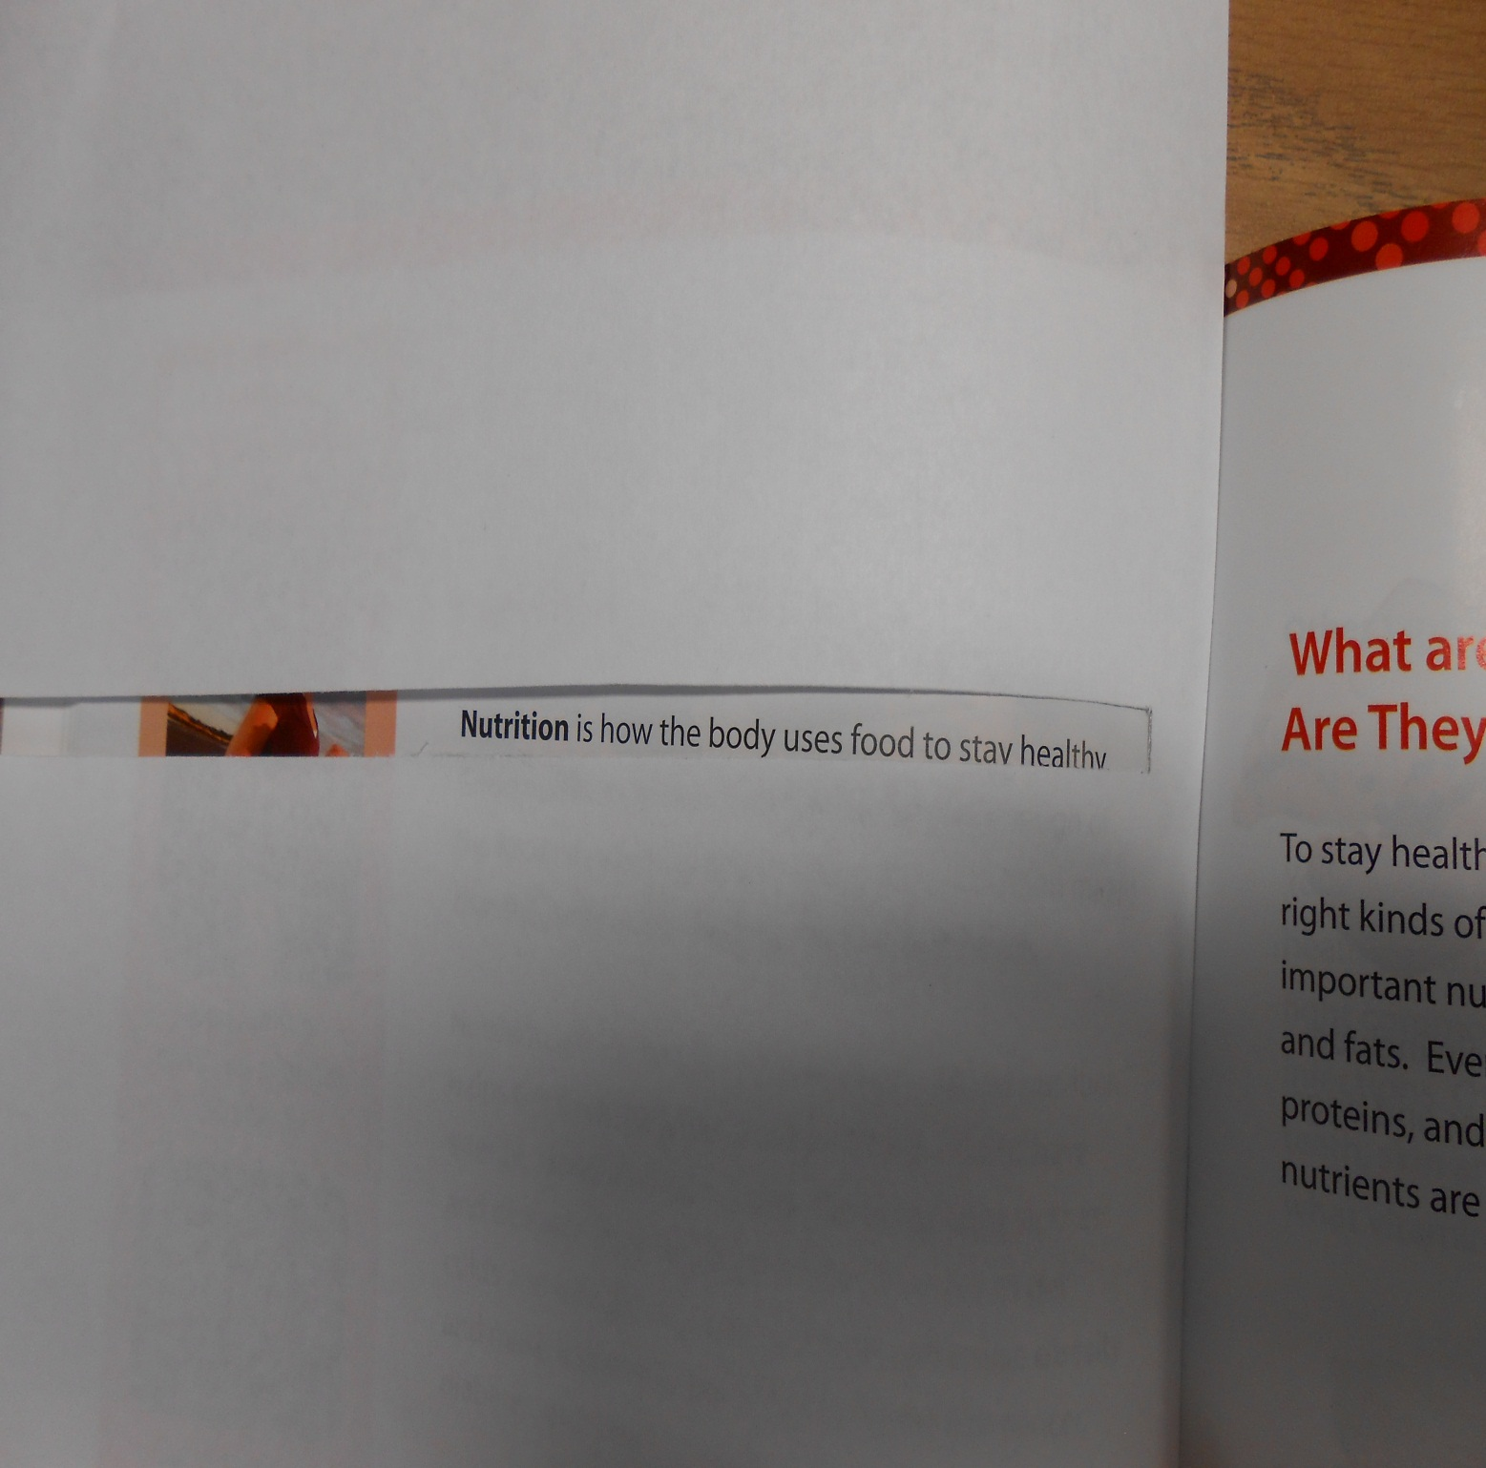

Slide 14
How to hold a pencil-the “pinch and rest”
Don’t squeeze the pencil
too tight.
Trace shapes over models.
Directionality- Left-> Right/ Top -> Bottom
Identify front side of page
Name & Date
BEST PRACTICES
Literacy Basics

Slide 15
Always start with what they know & build.
Use questions to activate schema,
or background knowledge,
before any reading or listening activity.
Use Environmental Print (symbols they
already recognize).
BEST PRACTICES
Activate Background Knowledge

Slide 16
Find out what health issues they have.
Use a needs assessment to discover
what they want to learn.
Increase motivation & retention by
using relevant materials & instruction.
BEST PRACTICES
Relevancy

Slide 17
Repetition is very, very, very, very important!! ☺
Always reinforce skills/vocab in more than one unit.
Use brain research, 10-24-7 strategy to move info from short-term to long-term memory. (Review in 10 minutes, 24 hours, and 7 days)
BEST PRACTICES
Repetition

Slide 18
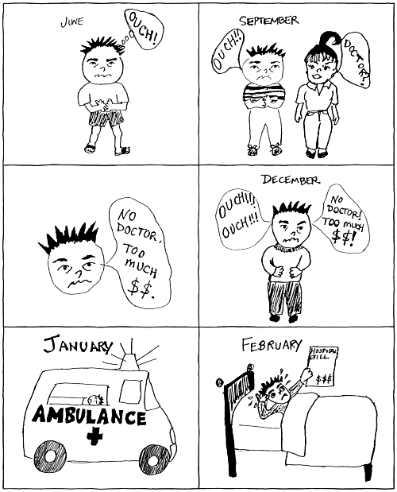
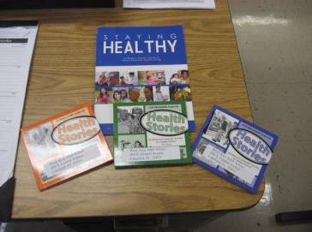
Picture Stories
ESOL CLASS LEVEL | MATERIALS USED
Foundations | Picture Stories, Basic Word by Word Picture Dictionary
Low Beginning | Introductory Health Stories
High Beginning | Low Beginning Health Stories
Low Intermediate | High Beginning Health Stories/ Staying Healthy
High Intermediate/Advanced | Staying Healthy

Slide 19
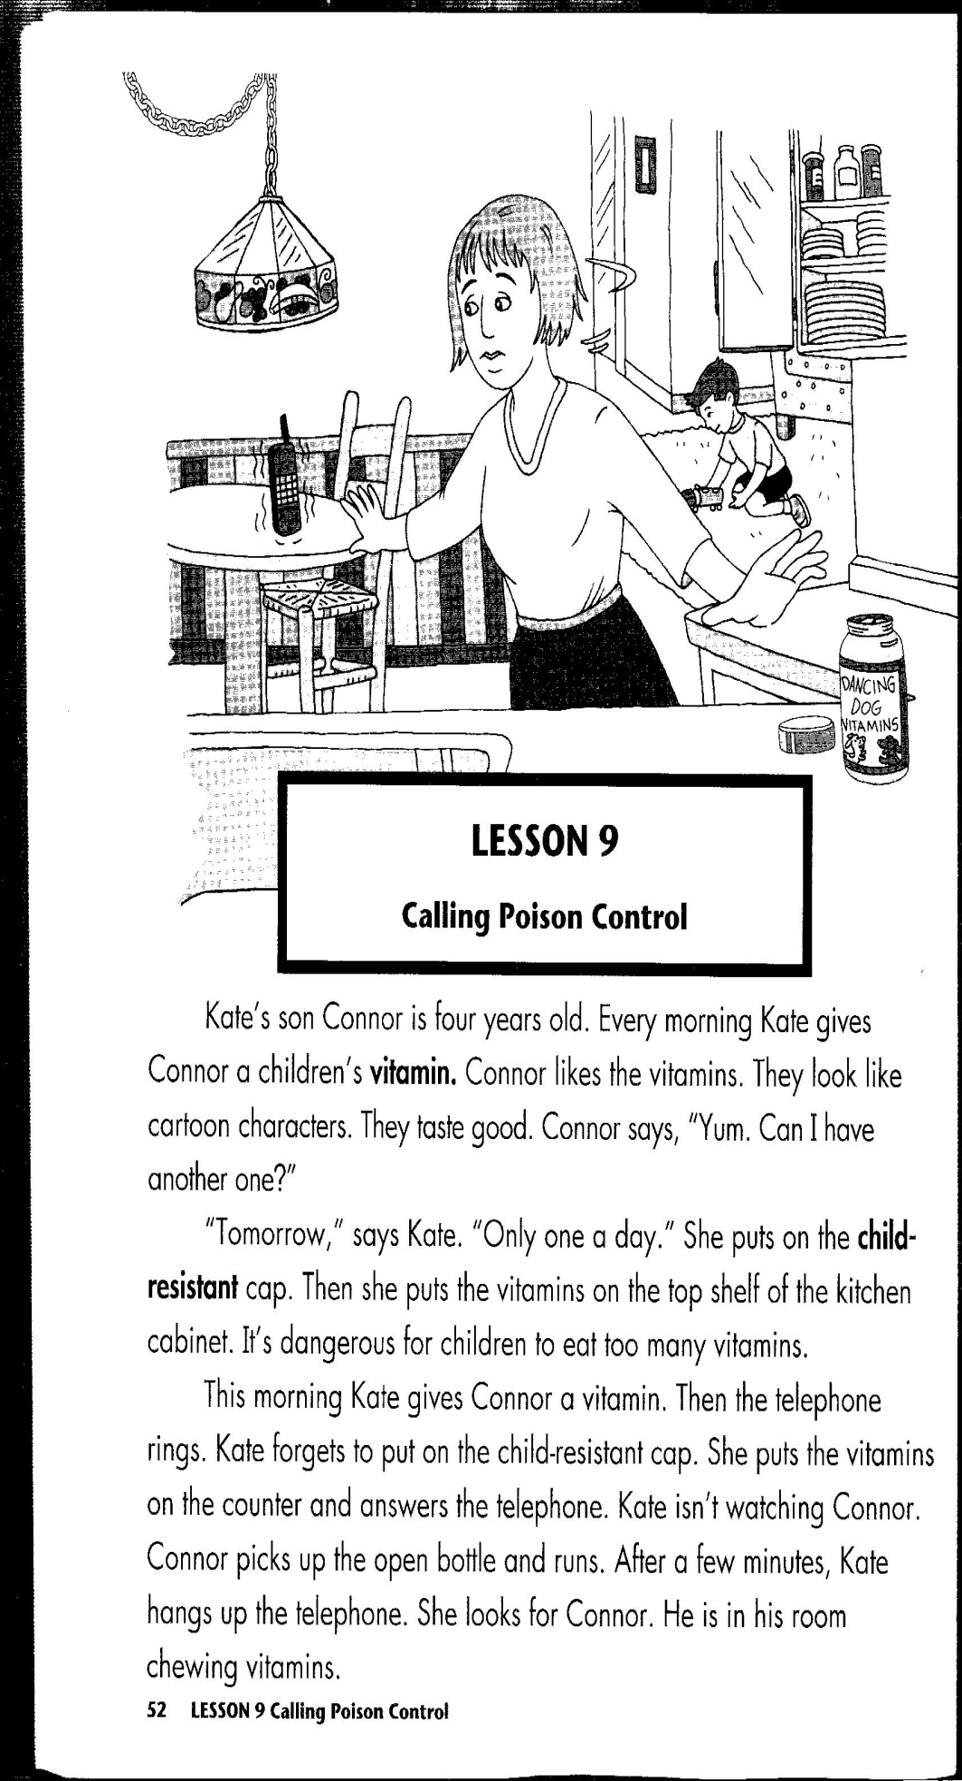
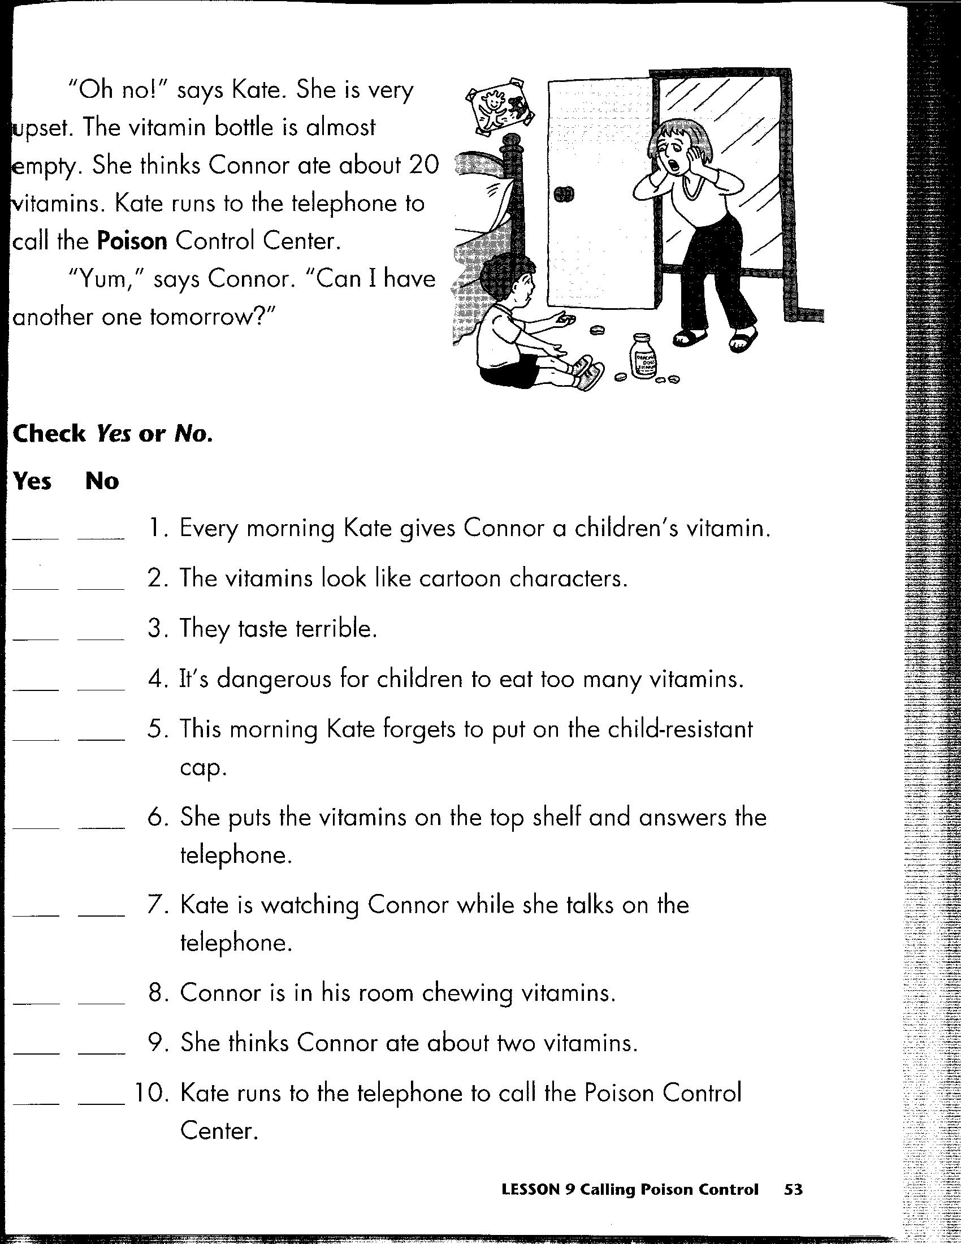
Sample pages from “Health Stories- Low Beginning”

Slide 20
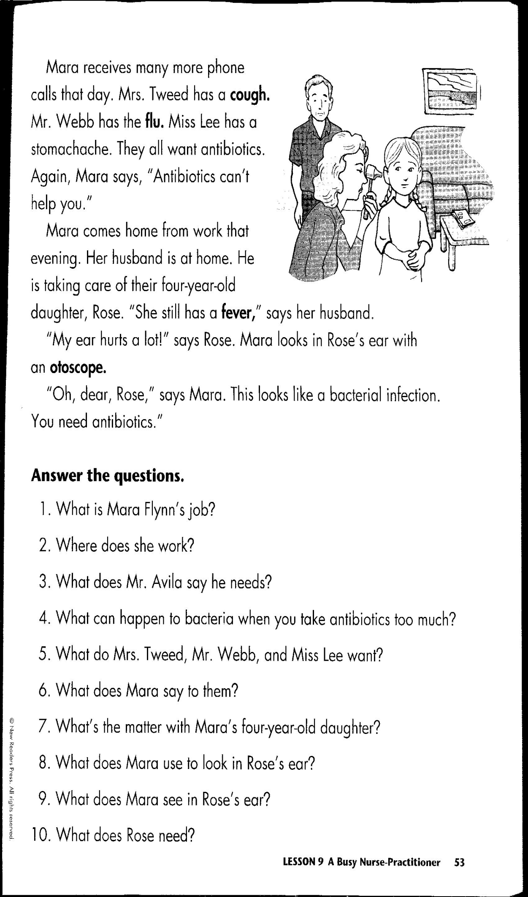
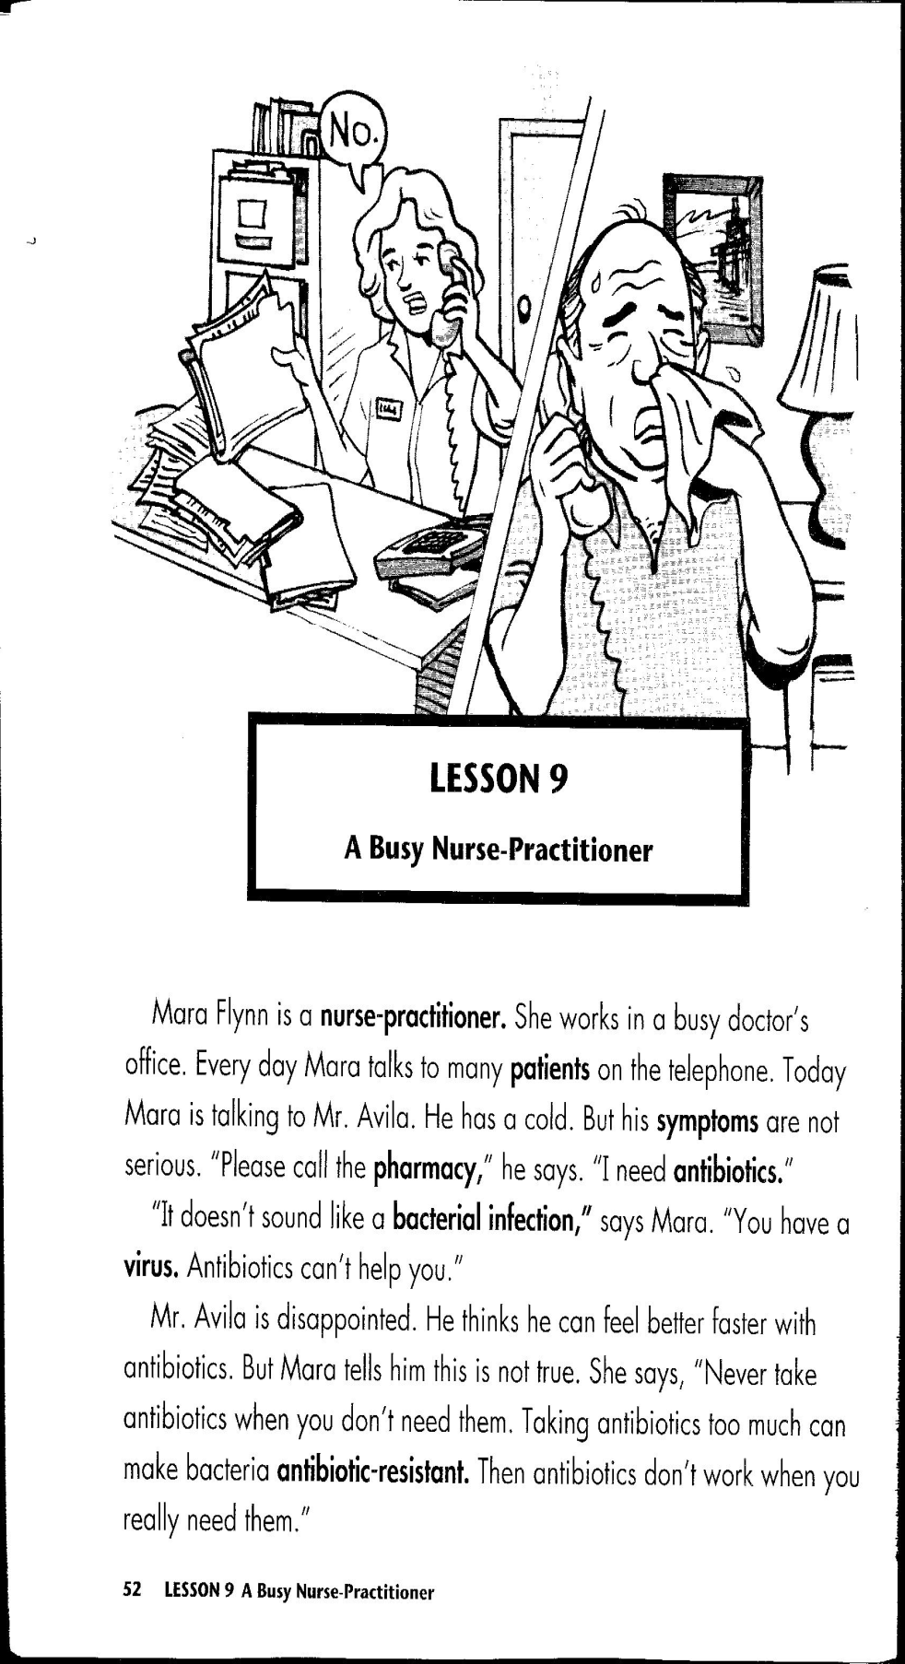
Sample pages from “Health Stories- High Beginning”

Slide 21
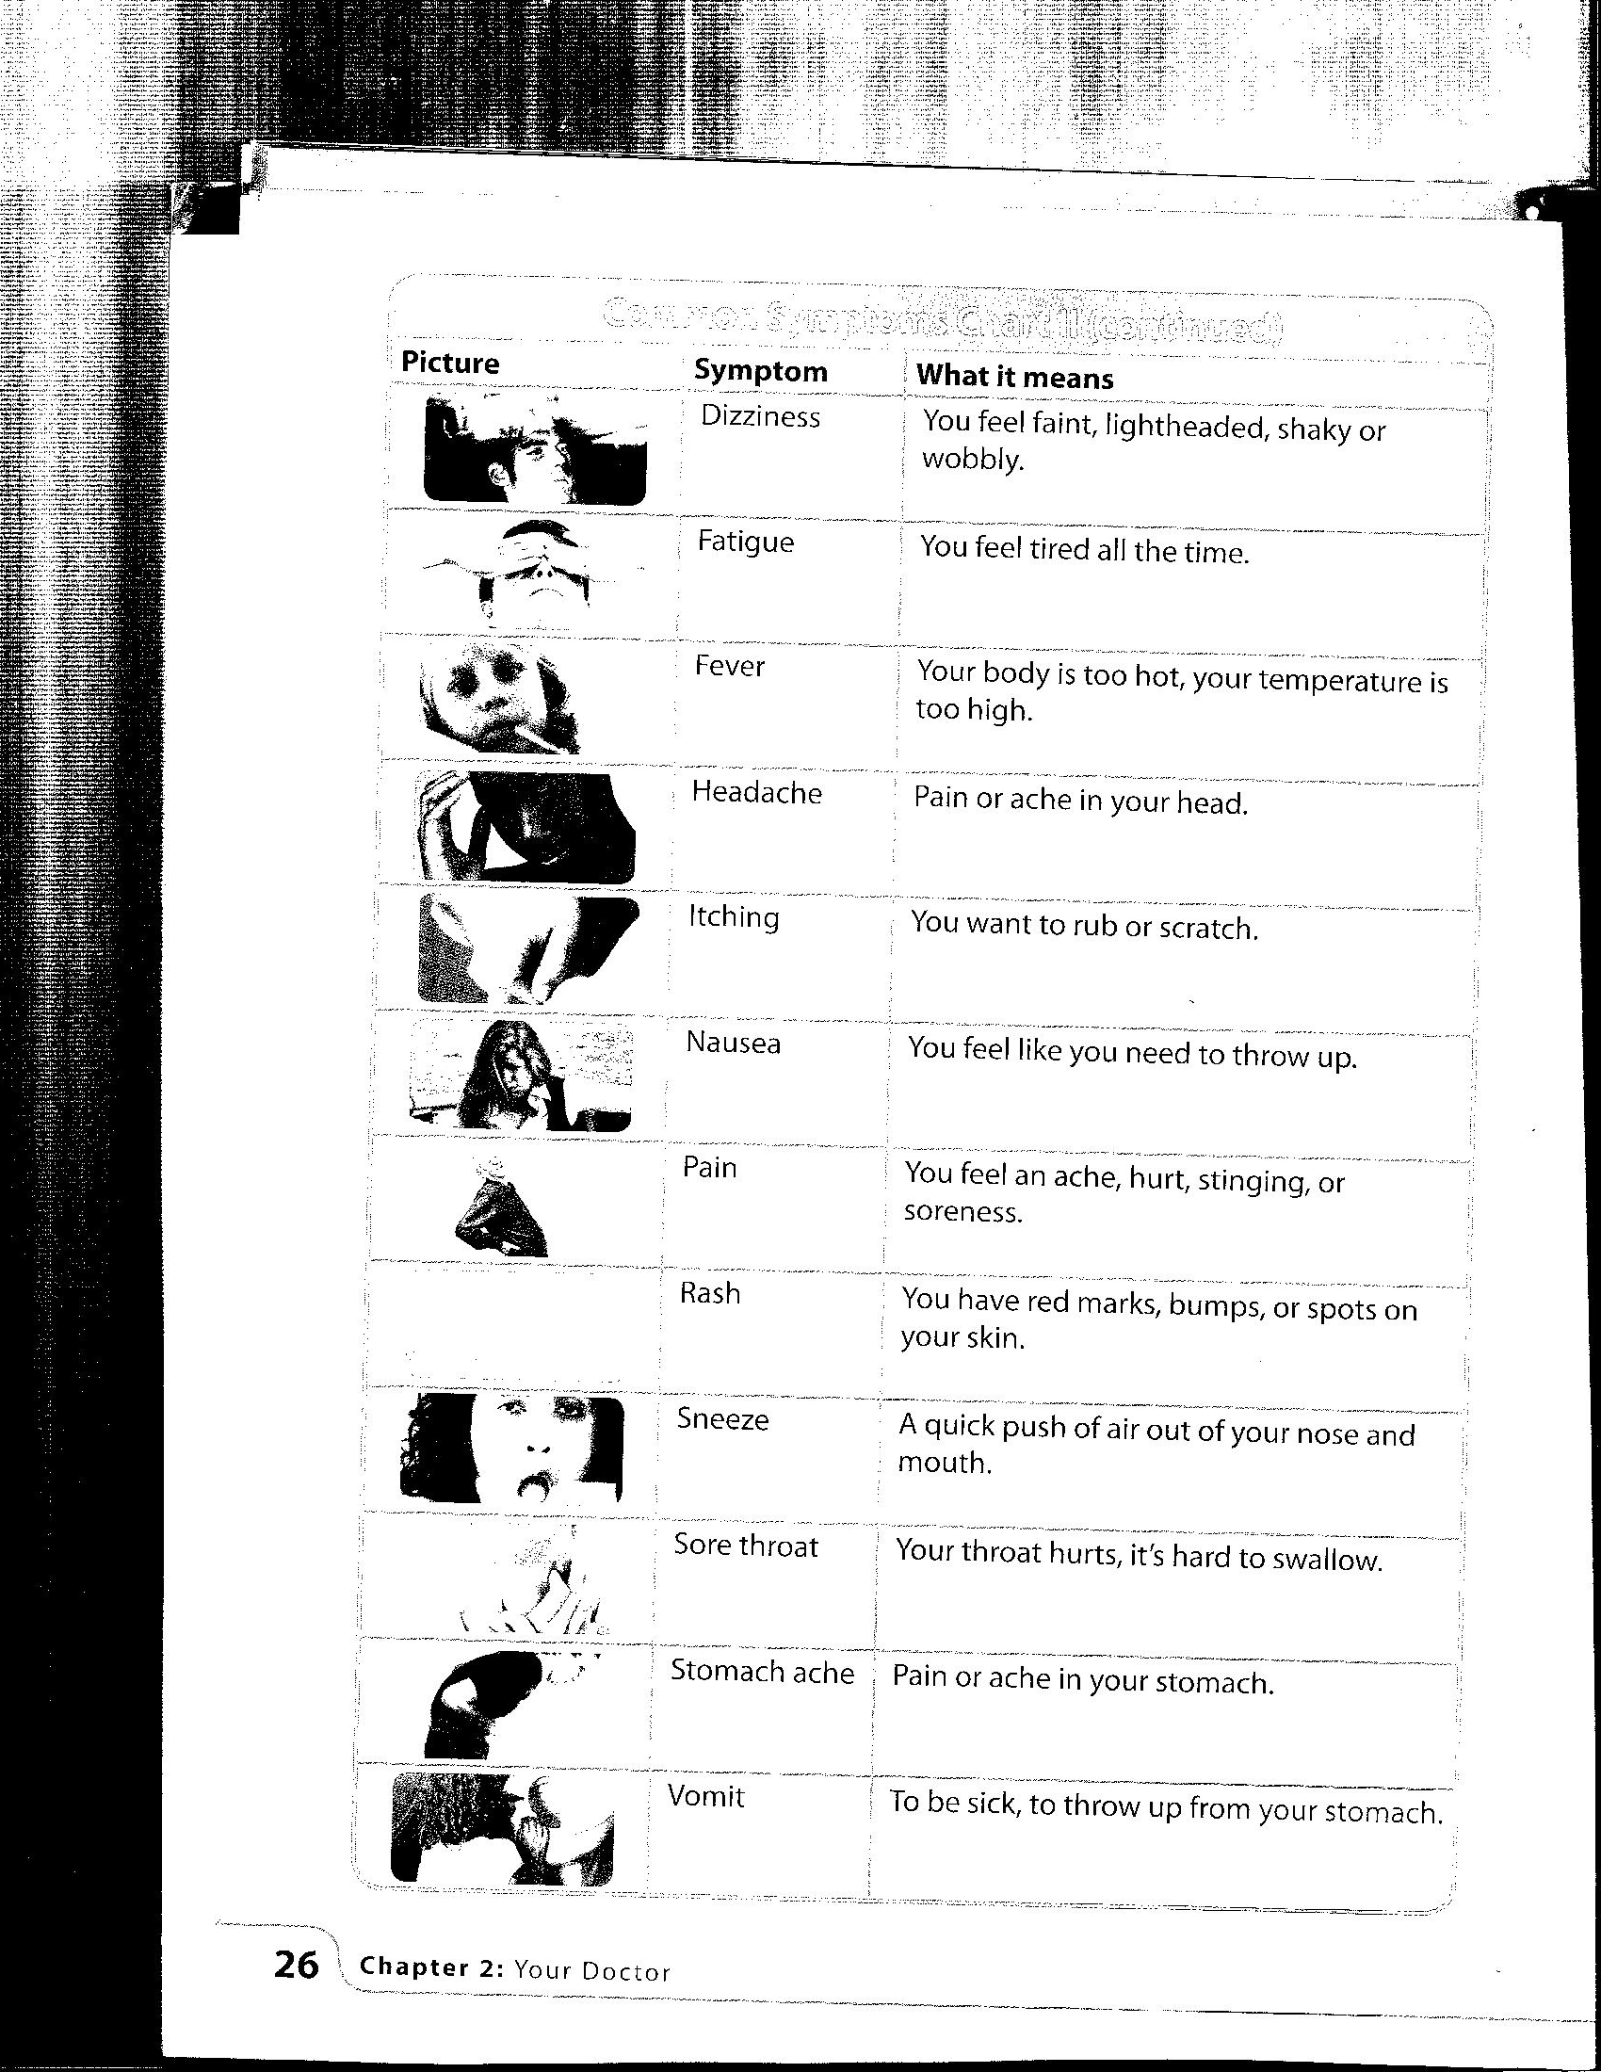
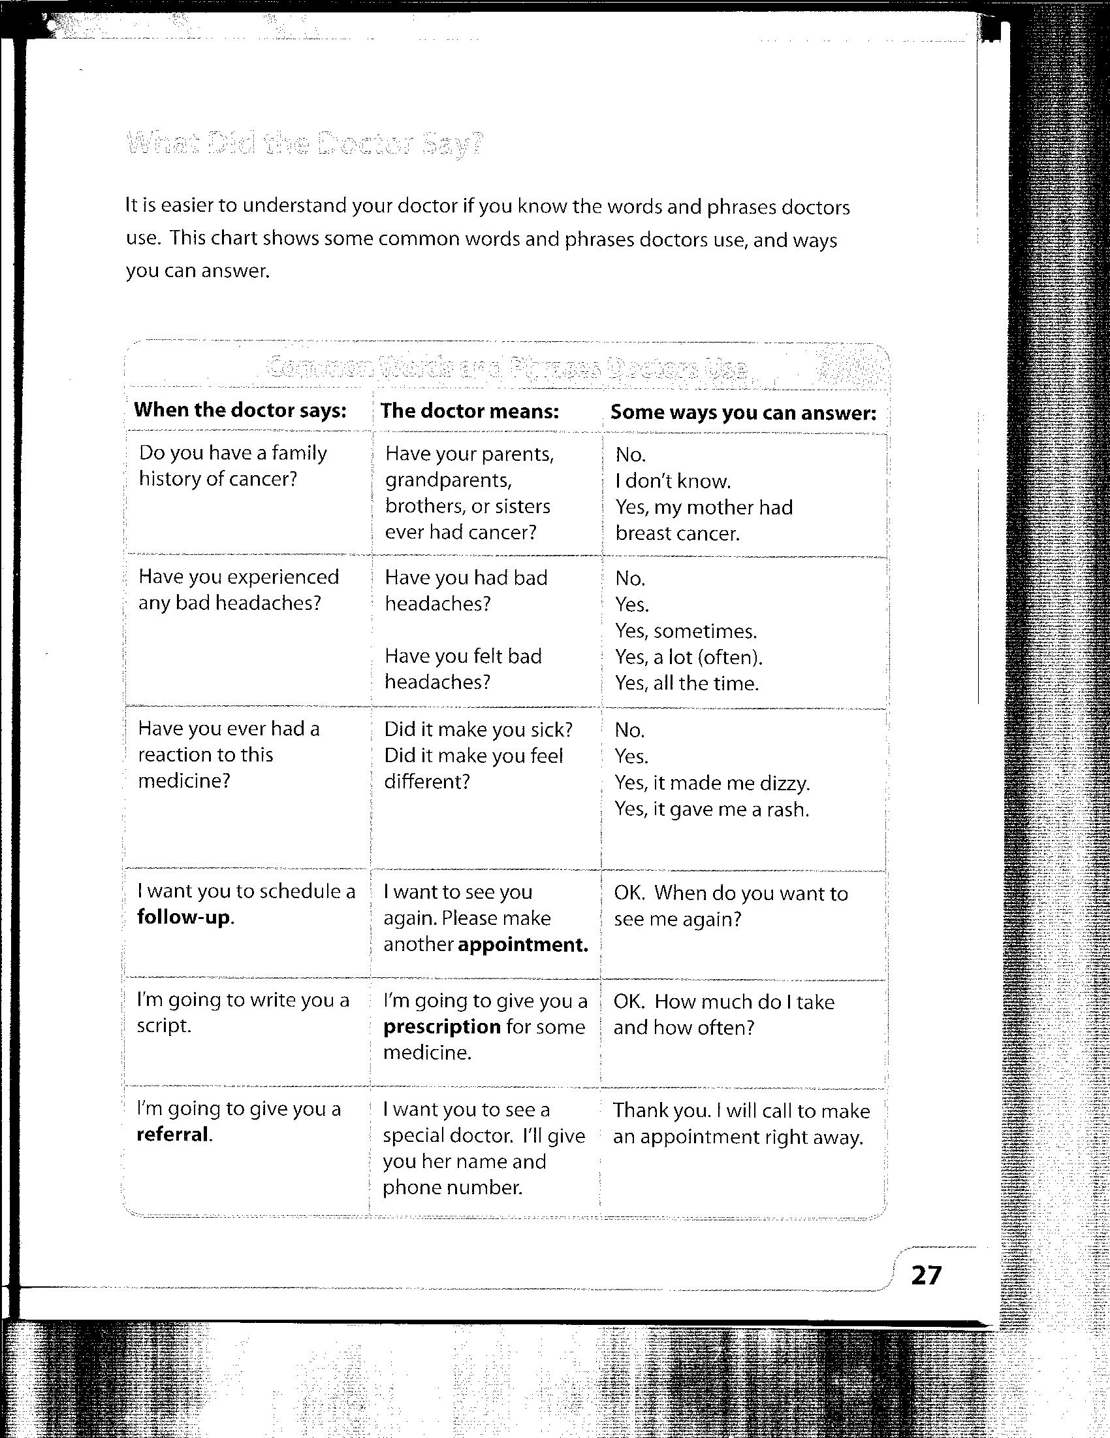
Sample pages from “Staying Healthy”

Slide 22
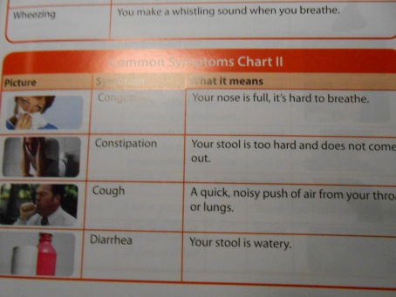
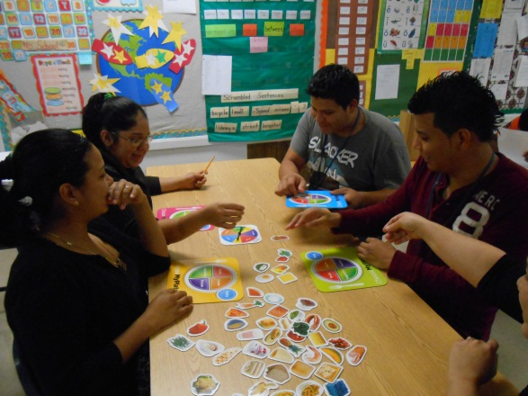
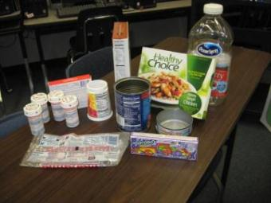
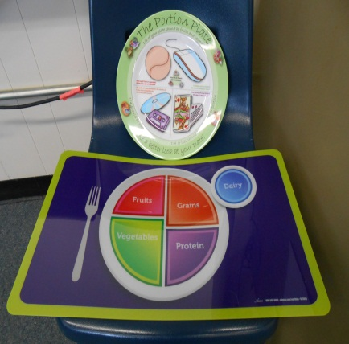
TOP 10 LIST: Best Activities for Low-Literacy ESOL Students
10.Grids
9. Language Experience Approach (LEA)
8.Picture Cards
7.Realia

Slide 23
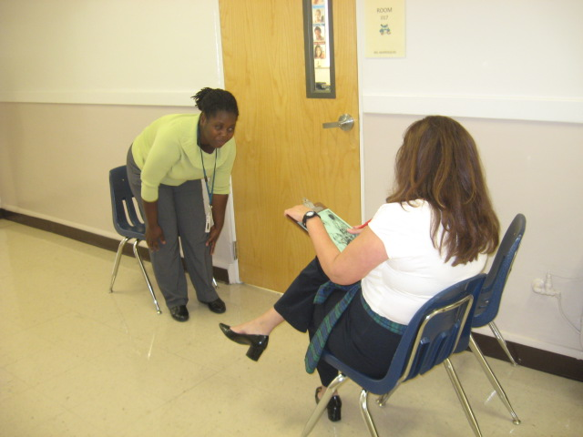
EMERGENCY
6.Picture Stories (See example →)
5. Music/Jazz Chants
4.Information Gap
3. Cross-Ability Grouping/Pair work
2. Role Play
1.Total Physical Response (TPR)

Slide 24
References
A conversation with FOB...What works for adult ESL students. (2003). Focus on Basics: Connecting Research & Practice, 6(C).
Croydon, A. (2005). Making it real: Teaching pre-literate adult refugee students. Tacoma Community House Training Project.
Gianola, A. (2007). Health stories: Readings and language activities for healthy choices. Syracuse, NY: New Readers Press.
Kurtz-Rossi, S., Lane, M. A., McKinney, J., Frost, J., & Smith, G. (2008). Staying Healthy: An English Learner's Guide to Health Care and Healthy Living. Florida Literacy Coalition.
Sharma, P. (2012). Strategies for Successful Students. In Strategies for Successful Students. World Education.
Singleton, K. (2004, November 23). Picture Stories for Adult ESL Health Literacy. Retrieved from http://www.cal.org/caela/esl_resources/Health/
Technical Assistance Paper: Adult English for speakers of other languages program (Publication). (2012). Tallahassee, FL: Florida Department of Education.

Slide 25





If you have any questions or
would like a copy of this
presentation, contact me at:
Lori.Cabrera@polk-fl.net
Thanks for joining us.☺
Enjoy the rest of your day.

